Slide 1


Slide 2
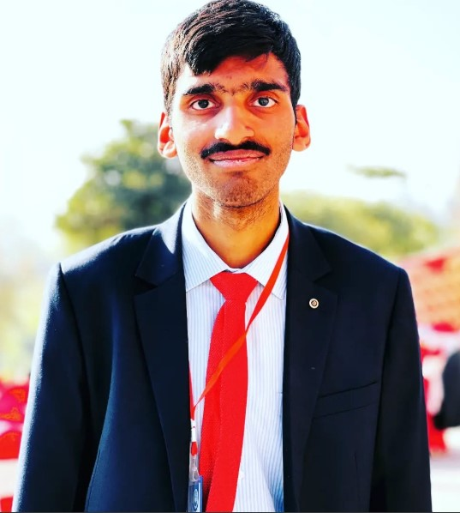
MACHADEV PROFESSIONAL PRESENTATION
PRESENTED BY
HUZAIFA SHAHBAZ
PRESENTED TO
MACHADEV

Slide 3
OUTLINES
INTRODUCTION
STRENGTHS
WEAKNESS
Areas that I am Developing
My Role at MachaDev
MY JOURNEY AT MACHADEV
MY MISSION AT MACHADEV

Slide 4
INTRODUCTION
I am graduate computer engineer from HITEC UNIVERSITY.
I am currently serving as a Trainee R&D here at MachaDev.
My final year project was IOT-BASED AIR QUALITY INDEX METER SYSTEM.
I DID TWO INTERNSHIP AT TWO DIFFERNET COMPANIES THAT ARE RISETECH AND MACHADEV.

Slide 5
STRENGTHS
Technical Versatility Proficient across both hardware and software domains - from embedded systems and IoT development to mobile app creation.
Problem-Solving Mindset Successfully completed complex projects like IoT-based air quality monitoring systems and digital processor designs
Rapid Learning Quickly adapt to new technologies and development environments.

Slide 6
Areas that I am Developing
Industry Experience While I have strong academic foundations, I'm actively building real-world engineering experience through internships.
Advanced Project Management Learning to coordinate larger-scale projects and work within established development workflows.
Communication Skills Continuously improving my ability to present technical concepts to diverse audiences.

Slide 7
My Weakness
Industry Experience While I have strong academic foundations, I'm still building real-world R&D experience and understanding industry research cycles.
Advanced Research Methodologies Learning to balance experimental exploration with practical timelines and resource constraints.
Cross-functional Collaboration Developing skills to effectively communicate complex research findings to non-technical stakeholders.
Long-term Project Patience: As someone used to academic project cycles, I'm adapting to the longer timelines inherent in R&D work where breakthrough results may take months to achieve.

Slide 8
My Role at MachaDev
As a Trainee R&D since September 2025, I contribute to our team's success through.
Primary Responsibilities
Research & Development Exploring innovative IOT solutions and embedded system architectures.
Experimental Development Prototyping and testing new firmware approaches and hardware configurations.
Technical Research Investigating cutting-edge technologies and methodologies for future implementation.
Technical Contributions
Leveraging my expertise in C/C++, Python, and embedded platforms like ESP32 for R&D projects.
Contributing innovative research approaches to advance MachaDev's technological capabilities.

Slide 9
MY JOURNEY AT MACHADEV
How I Got Here
My path to MachaDev began with a strong foundation in computer engineering, where I discovered my passion for IoT and embedded systems.
My previous internship at RISETECH AND MACHADEV provided valuable experience in CAD/CAM design ,embedded systems and network configuration, preparing me for the challenges I'd face here.

Slide 10
MY JOURNEY AT MACHADEV
Growth Since Joining
Research Integration Transitioned from academic projects to industry R&D methodologies.
Innovation Focus Learning to balance experimental approaches with practical implementation requirements.
Technical Exploration Applying classroom knowledge to explore new technological possibilities.

Slide 11
MY JOURNEY AT MACHADEV
Key Milestones
Successfully integrated into ongoing R&D initiatives and research projects.
Contributed to experimental firmware solutions and prototype development.
Demonstrated ability to bridge theoretical research with practical innovation.

Slide 12

MY MISSION AT MACHADEV
What Drives Me
I'm passionate about pushing the boundaries of what's possible with technology. In my R&D role at MachaDev, I'm motivated by.
Innovation Exploring cutting-edge IOT solutions and embedded system possibilities.
Research Excellence Bringing academic rigor and experimental thinking to our R&D processes.
Technological Advancement Developing solutions that position MachaDev at the forefront of industry innovation

Slide 13
MY MISSION AT MACHADEV
My Goals
Short-term R&D methodologies and contribute meaningfully to current research initiatives.
Medium-term Lead experimental projects in embedded systems and IOT innovation.
Long-term Become a research leader who can drive breakthrough technologies and mentor future R&D talent

Slide 14
MY MISSION AT MACHADEV
Value I Bring to MachaDev
Fresh Perspective Academic insights combined with hands-on project experience.
Technical Versatility Ability to work across multiple domains - from circuit design to mobile app development.
Commitment to Excellence Track record of consistent high performance and continuous learning.

Slide 15
CONCLUSION
My journey at MachaDev has been one of growth, learning, and innovation.
I’ve transitioned from academic projects to real-world R&D contributions.
With my technical versatility, problem-solving mindset, and commitment to excellence, I aim to add long-term value.
Looking ahead, I’m excited to drive innovation, explore cutting-edge IOT and embedded systems, and grow as a future R&D leader.
Together, we can push MachaDev to the forefront of technological advancement.

Slide 16


